Slide 1
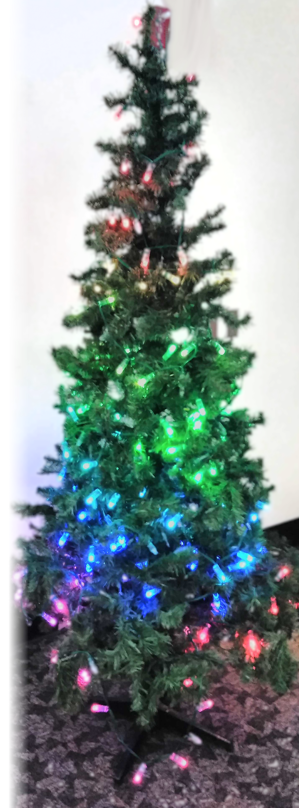
Learning Holiday Lights
SDDec19-10
Client : Dr Daniels
Jake Grace | Software Lead
Chad Griggs | Report Manager
Joe Nunez | Meeting Scribe
Thien Nguyen | Webmaster
Valery Smith | Signal Processing Specialist
Steven Williams | Hardware Lead

Slide 2
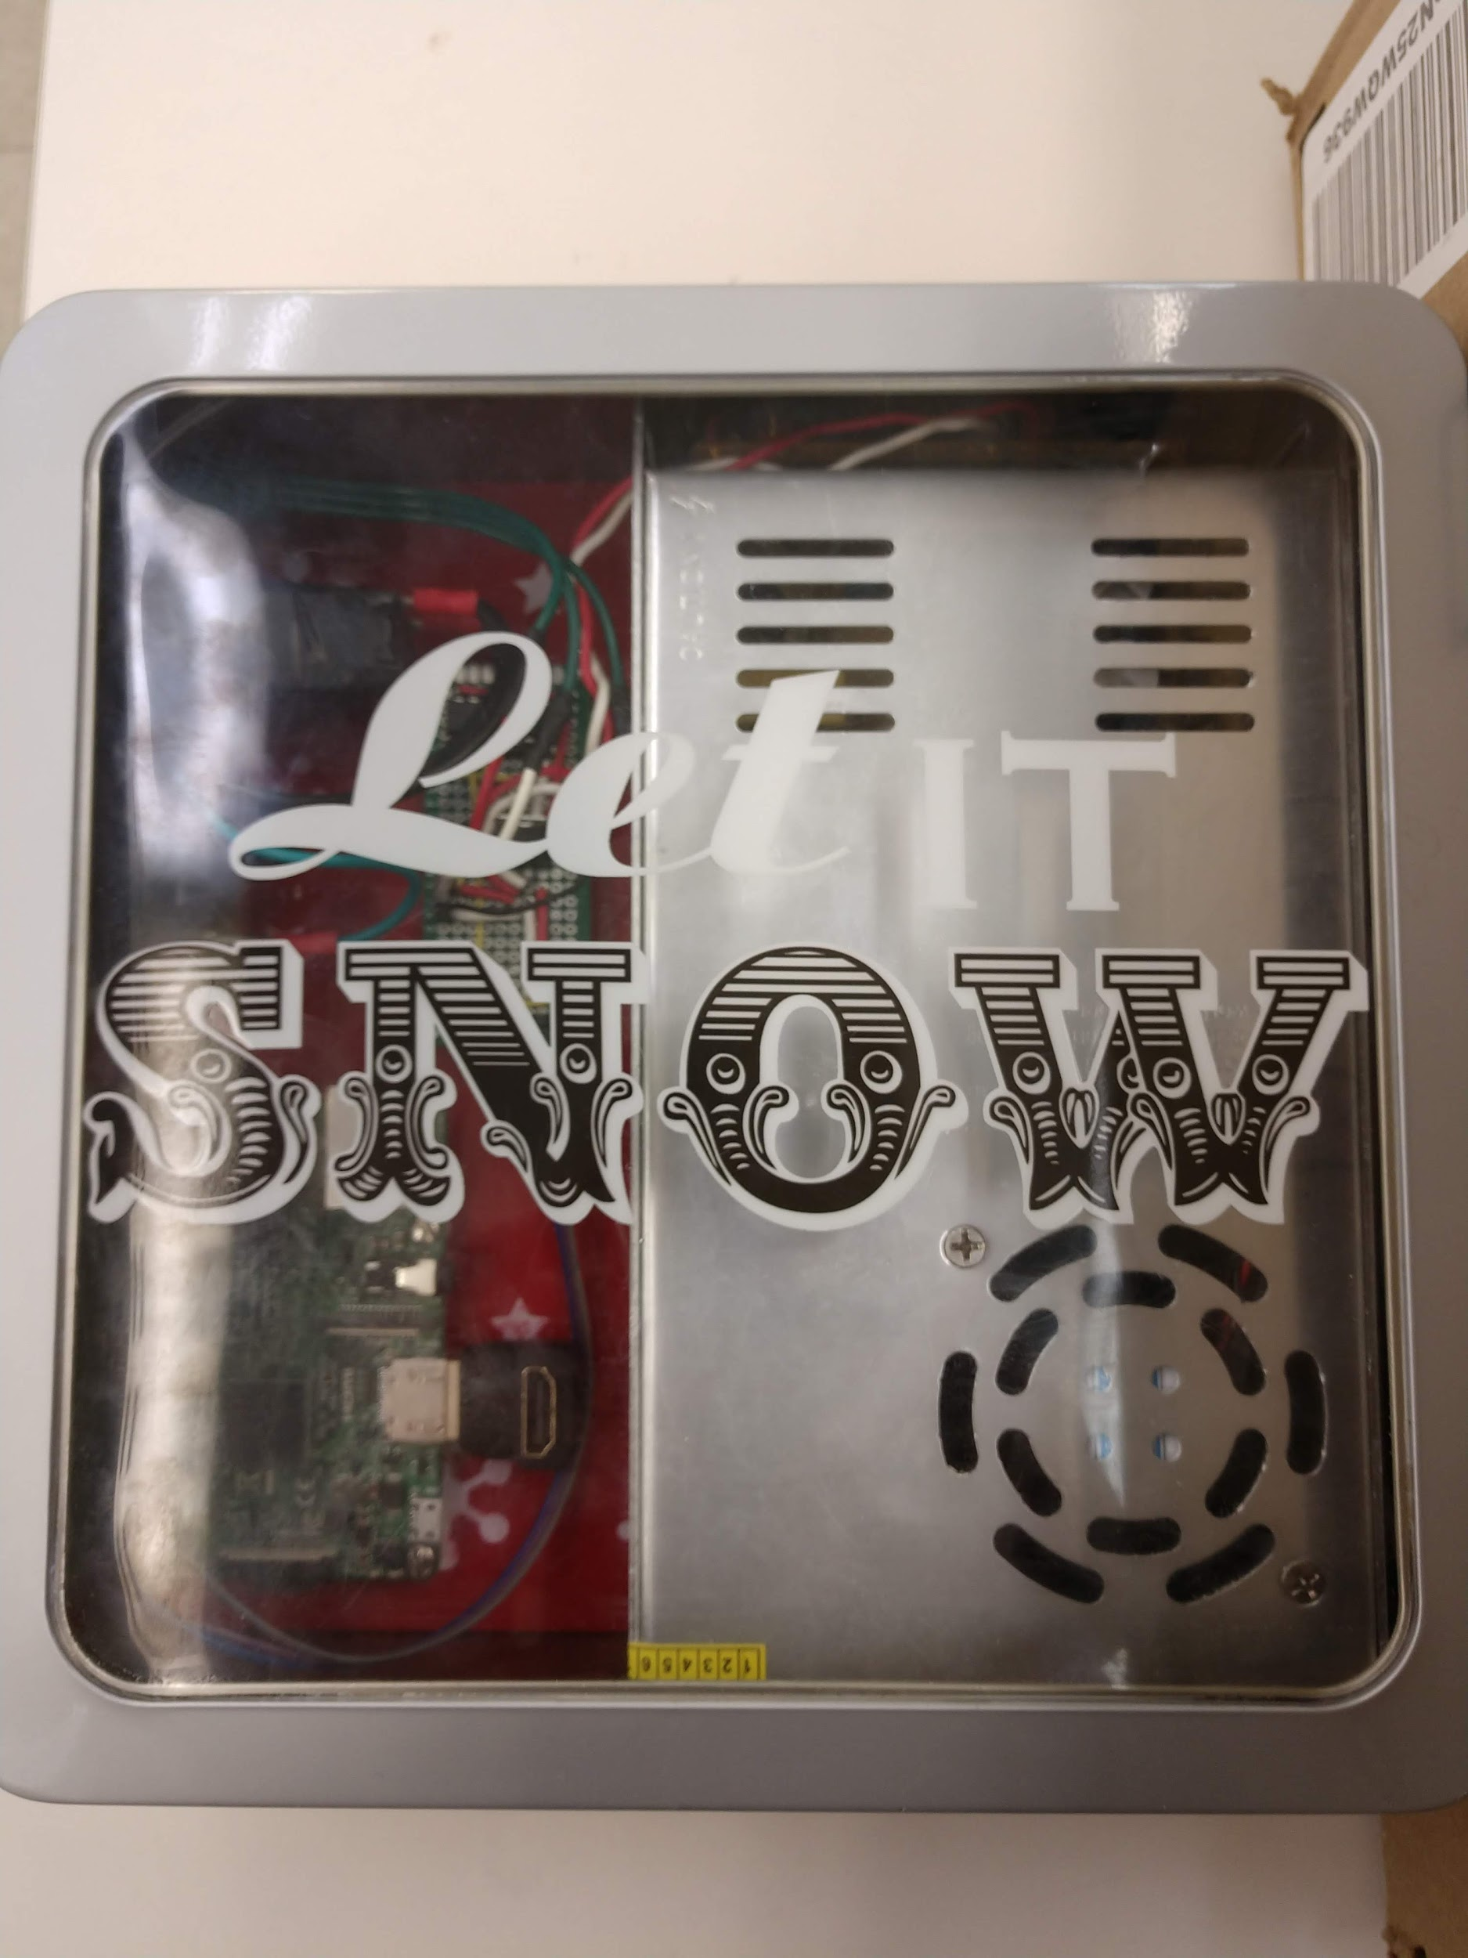
Problem Statement
Current Christmas lights are outdated
Show Christmas spirit
Major upgrade of current Christmas lights
Create stunning, dynamic displays
Choose and create your own patterns to display
Continuation of team SDDec18-10 project “Holiday Reverse Programmable Light Strings”
SDDec19-10
Notes:
Chad- Today’s current Christmas tree lights are outdated and have not changed for several years We want to create a new and exciting way to show your Christmas spirit, impress your friends and family, and celebrate the holiday Our product is a major upgrade to the Christmas lights of today Our lights are capable of stunning displays that can change at any time Once the lights are set up, the user can display dynamic images and patterns of their choosing on the tree

Slide 3
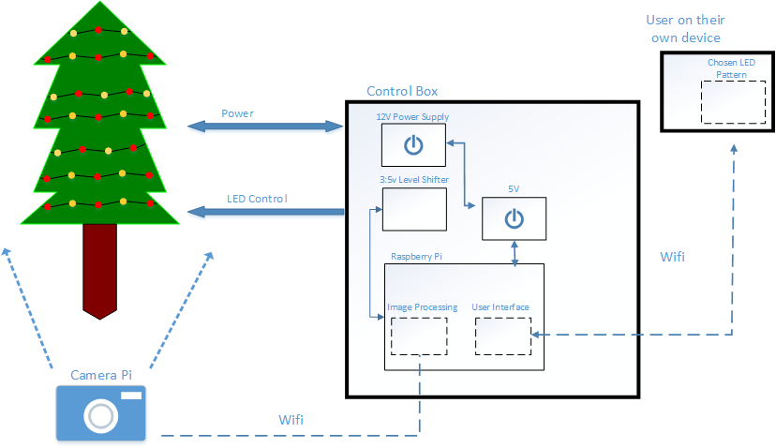
Concept Sketch
SDDec19-10
Notes:
Valery

Slide 4
Project Deliverables
User Interface
User friendly web-application on senior design website
Upload images to be mapped to the tree or customize built in patterns
Lights and Control Box
Contains Raspberry Pi, power supply, and other necessary circuit components
Calibration Algorithm
Method by which the system will determine the location of each LED
User Manual
Set-up guide, instructions, and proper set-up technique
SDDec19-10
Notes:
Chad
User Interface: The user interface will be a user-friendly web application hosted on our senior design website. We would like to use WebSockets to have the server push events to the pi to control the lights. On the user interface the user can either upload images files to be texture mapped to the LEDs on the tree or design a basic pattern to be displayed such as a rotating rainbow or other select colors.
Lights and Control/Powerbox: The control/power box contains a 12v power supply, a 5v:3v step-down converter, and a Raspberry Pi. The lights are WS2811 LED/chipsets. Python files will be controlling the Raspberry Pi’s PWM pin that is connected to the WS2811 LEDs.
Calibration Method: The method by which the system will determine the location of each
individual LED on the tree. It will utilize camera images captured by a PiCam to be processed on the Raspberry Pi.
User Manual: a pdf detailing how to set-up, calibrate, change designs, and take down the system in an easily readable way. This document will contain diagrams and images to help guide the user.

Slide 5
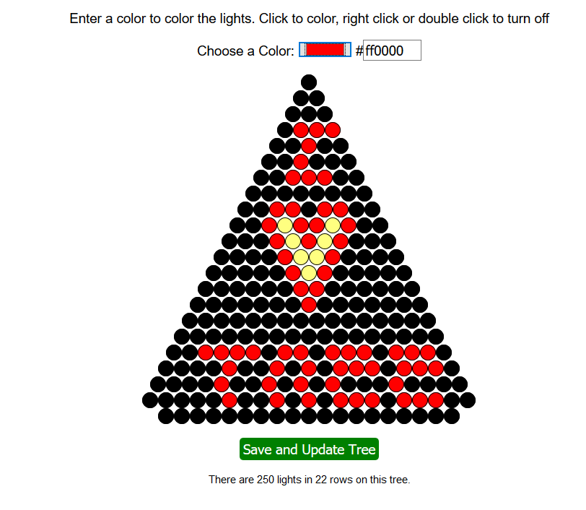
Functional Requirements
The system should:
Display Graphics and Text
Auto-calibrate the individual LEDs
Have a web application to control the LEDs
Contain two Raspberry Pis connected to the customers home WiFi Network
SDDec19-10
Notes:
Joe -
The system should be able to display graphics and text on the tree, including images, patterns and animations The LEDs strung on the tree should also have the ability to be auto-calibrated and manually calibrated Each individual LED should also be controllable from a web application allowing for the tree LEDs to be designed and updated in real time Two Rasberry Pis will be used, one as a controller Pi to issue commands to the tree and a second Pi being the camera Pi This Pi will be solely used in conjunction with a Pi NoIR camera V2 to take images of the tree during the calibration sequence, determine the order and orientation of each individual light, and then send this information to the control Pi

Slide 6
Constraints & Non-Functional Requirements
Constraints
The system as a whole should not be over budget (>$300)
The system should be portable
The system should be easy to use
Non-Functional Requirements
The wireless communication should not be vulnerable
The strands of lights should be easily expandable
SDDec19-10
Notes:
TN
Can prob go through this quick
We should work under the previous team’s strucutre. That means taking all their hardware components they left behind and any legacy code. It was up to us to keep it and work upon it (saves us time) -- or go straight from scratch. Debatable on which was the right decision -- we kept the hardware (monetary), and ditched software (time)
Example constaints while designing this would be designing the whole thing should be within a reasonable budget for other client -- approximately 300USD. Most of the material resource cost will be coming up within a following slide.
The item itself should be portable. You should be able to carry it across your house -- the container and the strand of lights are light weight enough (you don’t need to bring a tree) -- and can bring the lights elsewhere/wrapped.
Easy to use -- so simple a child can understand it. Jokes aside, the client should be easy to understand the process to set it up without having a specialist set it up for him -- an easy to read manual, calibration -- a lot of automation can be involved in this step.
---
Non-Functional.
The wireless communication, because it broadcasts itself, its very possible that outside people can connect to the device and upload unwarranted pictures or hijack into the persons local network. We would need to find aform of security (SSH) or even a simple password.
Strand of lights
Easily Expandable. -- The pi should be able to adapt to the amount of lights/details on the image.

Slide 7
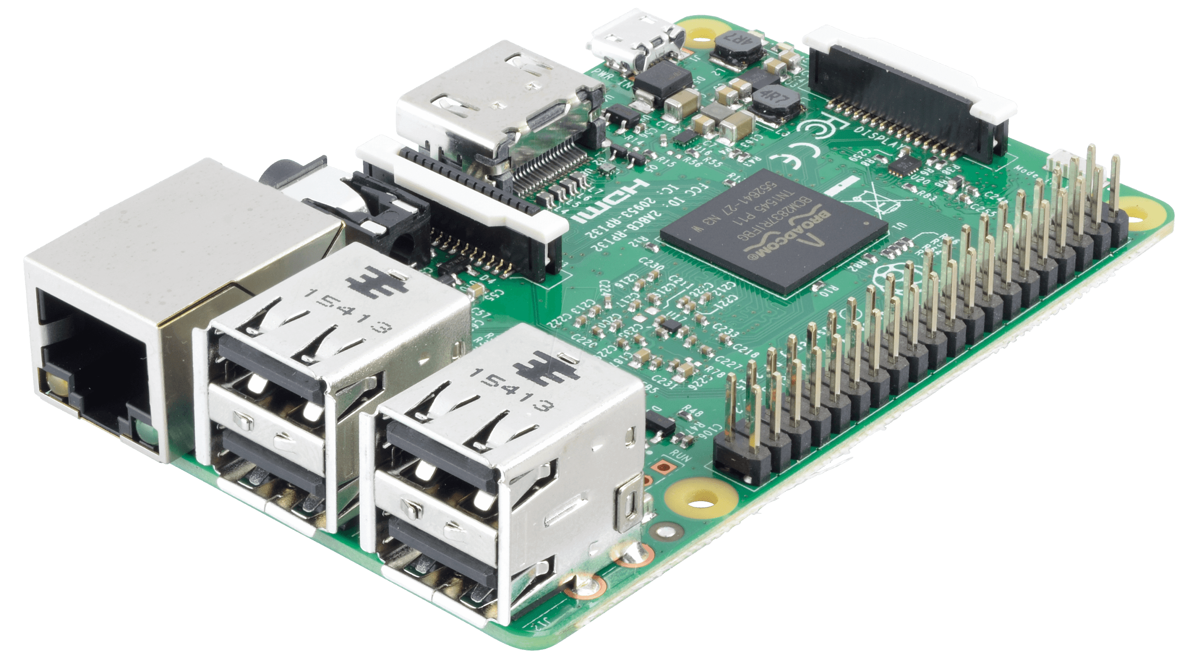
Technical/Other Considerations
Raspberry Pis
Camera
Server
Hardware Safety and Security
Lock down SSH, Wifi, and rPi login credentials
Fire, shock, choking hazards should be mitigated
Software
OpenCV for calibration
Adafruit NeoPixel LED strip library
Environment
Indoor use only
SDDec19-10
Notes:
Jake:

Slide 8
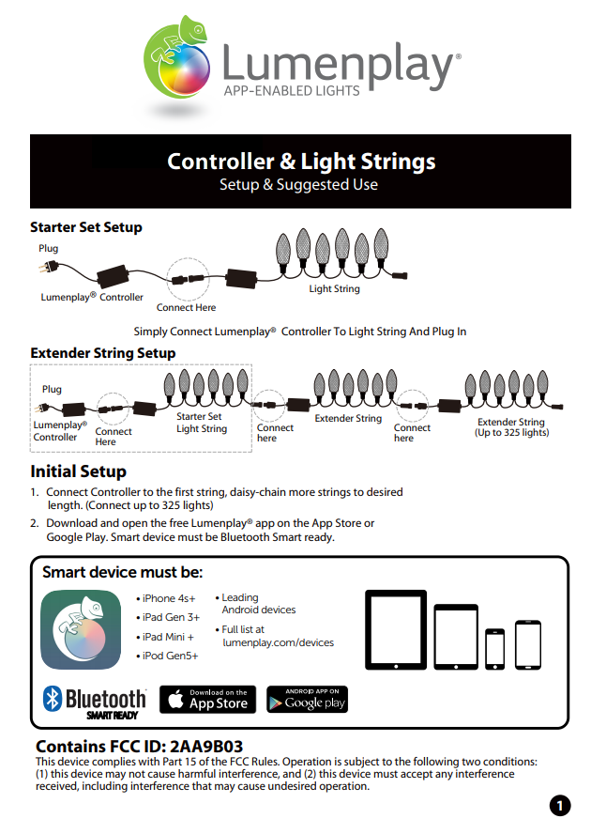
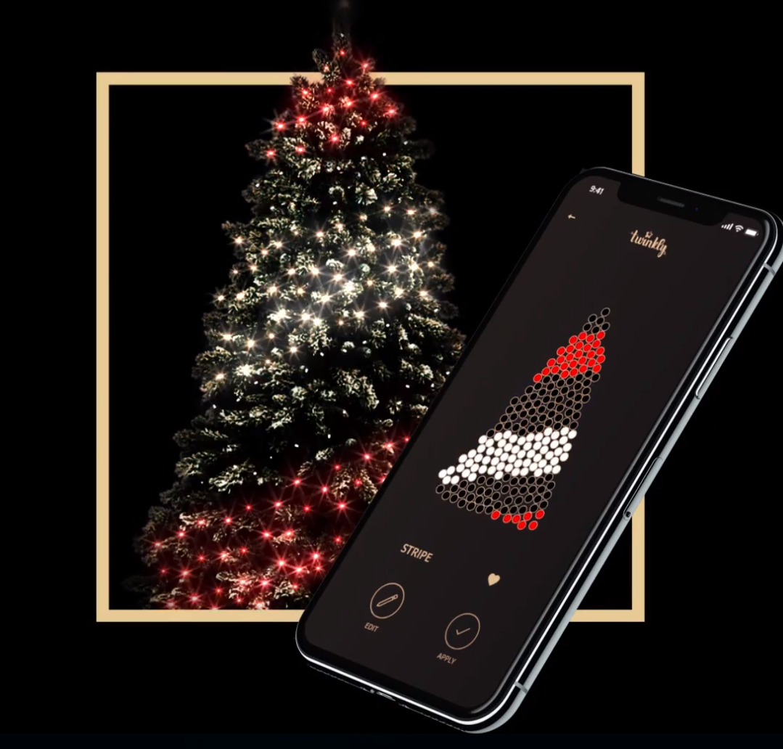
Market Survey
Twinkly
LumenPlay
SDDec19-10
Notes:
Steve - Niche market, few other competitors Advantage of ours is completely customizable (open source), uses web interface rather than app (requires no external software)
Our market is more pointed toward the hobbyist rather than the tech illiterate

Slide 9
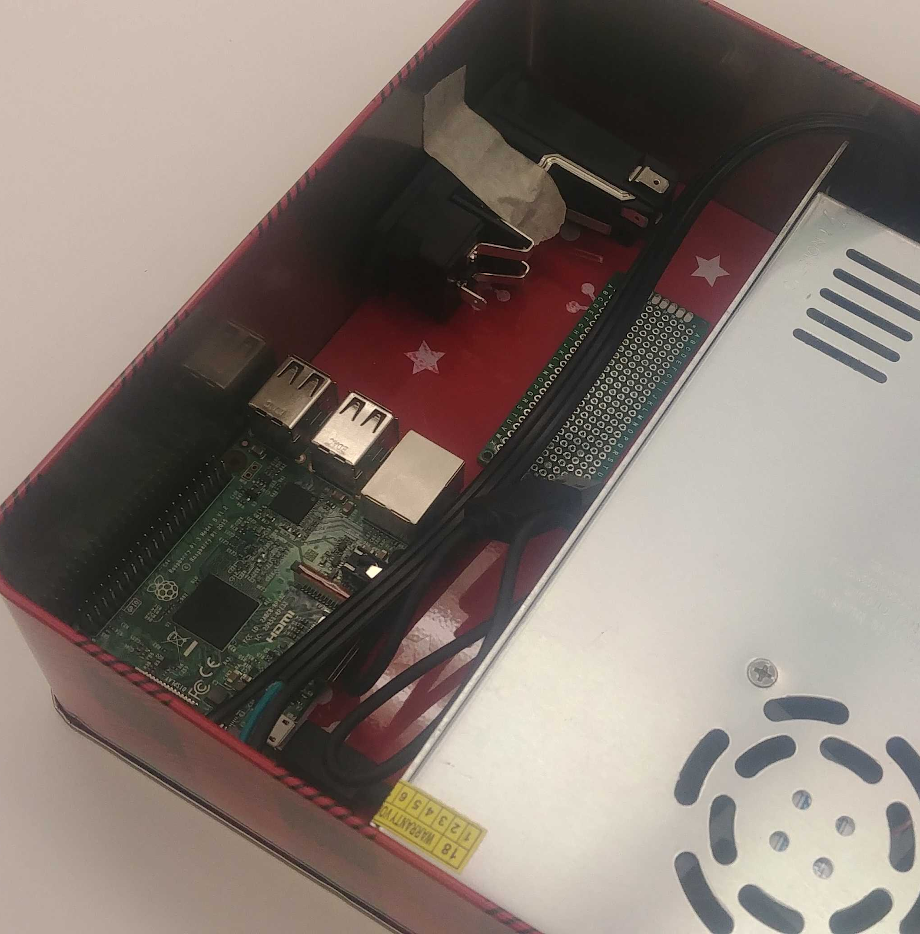
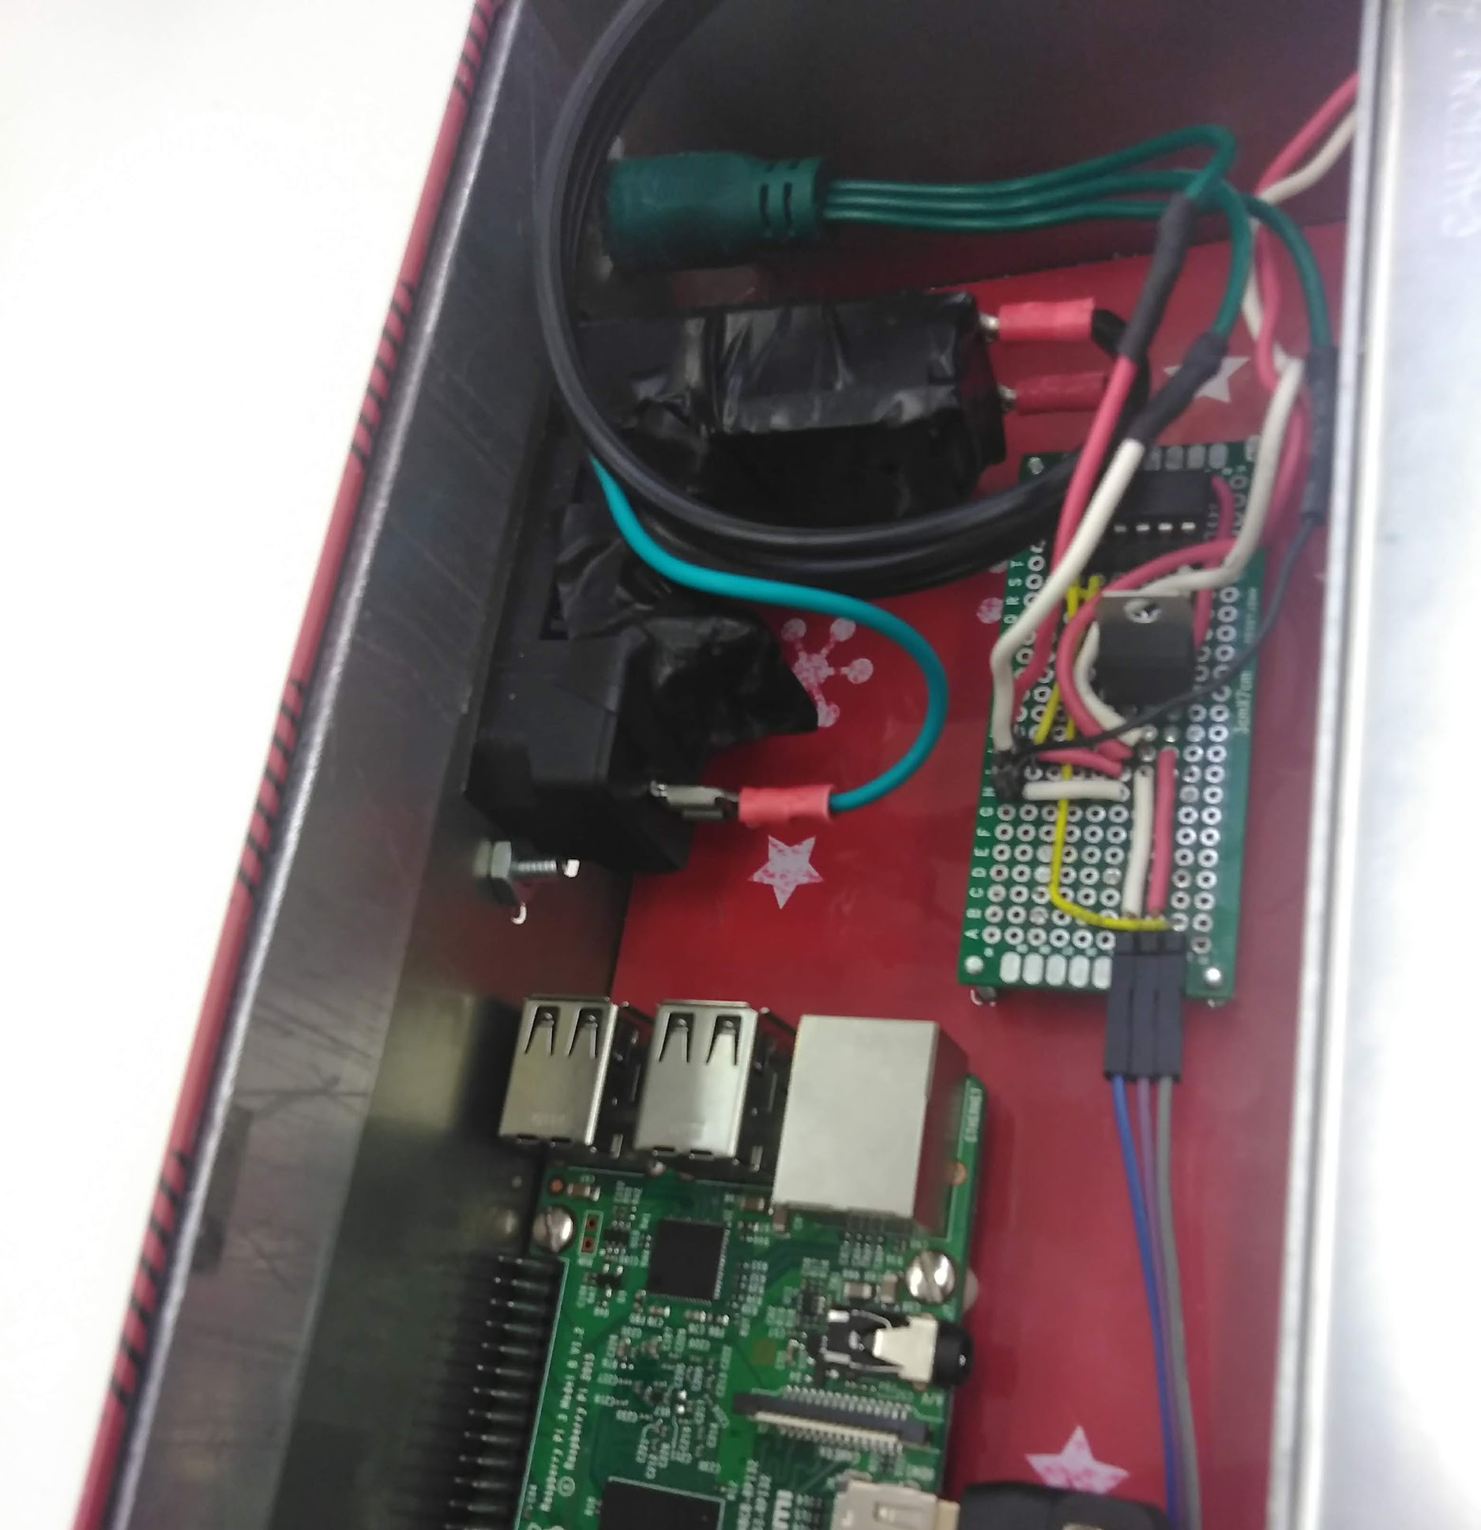
Potential Risks and Mitigation
Software:
Calibration Inaccuracies
OpenCV
Inexperience with python
Hardware:
Electric Shock
5V Regulator Failure
Fire
SDDec19-10
Notes:
Joe
Software - We need to ensure that the calibration technique that we use accounts for numerous possibilities One option we looked into was limiting the customer’s environment in which the system would work seamlessly, a second option would be utilizing image detection techniques such as using a gaussian blur to zero in on the LEDS as they light up in an effort to reduce the background noise of the image
Hardware: There's a change for an electric shock when handling the system if it’s improperly grounded We’re also running the Pi off of the same power supply that is used for the light strands Because the Pi is Piggybacking off of the power, we have to use a 5v Regulator to make sure the Pi is properly powered Should the regulator fail, the Pi would lose power and the system would be inoperable Finally, with such a large power supply (12v at 30 amps), we run into the risk of the heat generated catching something under the tree on fire such as a present or simply an unwatered tree

Slide 10
Resource Cost Estimate
Item | Description | Price
Raspberry Pi (1) | To process Pictures of tree and send data to light strand | $35
Raspberry Pi (2) | To store Pictures of tree and prepare for processing | $35
Pi Cam | To get Pictures of the tree | $14
LM7805 | To step down 12V to 5V for powering | $0.50
12V Power Supply | To step down supplied 120VAV to usable 12VDC | $18
IEC 320 C14 Standard Power Cable | To supply 120V power from power outlet to the power port and the 12V power supply | $5
Fused Power Port | To supply protected 120V power from a power outlet to the 12V power supply | $1.50
3V-5V logic converter | To step up 3.3V logic from Raspberry Pi to 5V logic to light strand | $0.50
Light Strand | To display patterns on a holiday tree | $15
SDDec19-10
Notes:
Steve

Slide 11
Resource Cost Estimate (cont)
Item | Description | Price
Wires | To interconnect circuit components | $0.50
Metal Case | To protect internal Pi, power supply, voltage controllers, and wiring from environment | $0
Camera Pi Case | To protect the camera Pi from the environment | $0.50
LCD Screens | To display information about the Raspberry Pi’s (ip, temperature, time, etc) | $10
Tripod | To hold the camera Pi steady while taking Pictures | $0
Raspberry Pi (2) Power Supply | To power the camera Pi | $1
SDDec19-10
Notes:
Steve

Slide 12
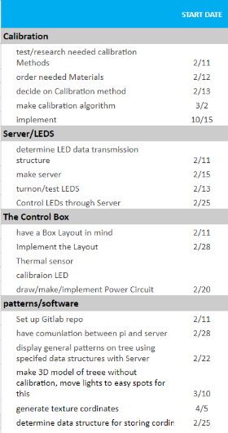
Milestones and Schedule
Turning on the lights using the power distribution system/control box
Displaying a pattern created on the user-interface
Displaying an image uploaded to the user-interface
Testing with users similar to our intended users and having them set-up and use the system
SDDec19-10
Notes:
Valery
Optimized for parallelism Reminders in Slack

Slide 13
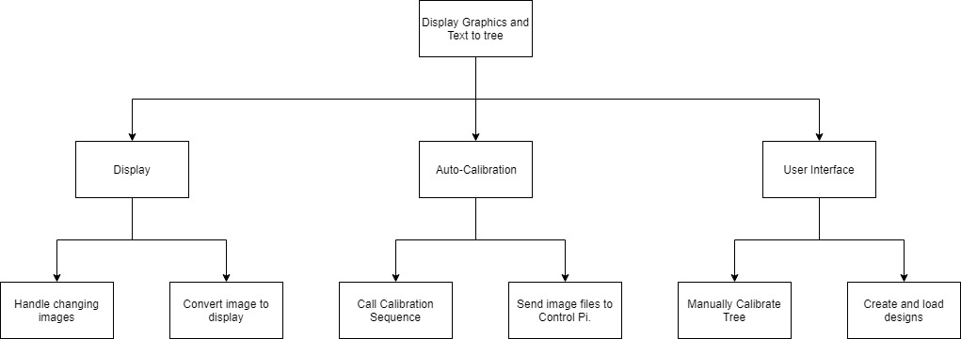
Functional Decomposition
SDDec19-10
Notes:
Joe -

Slide 14
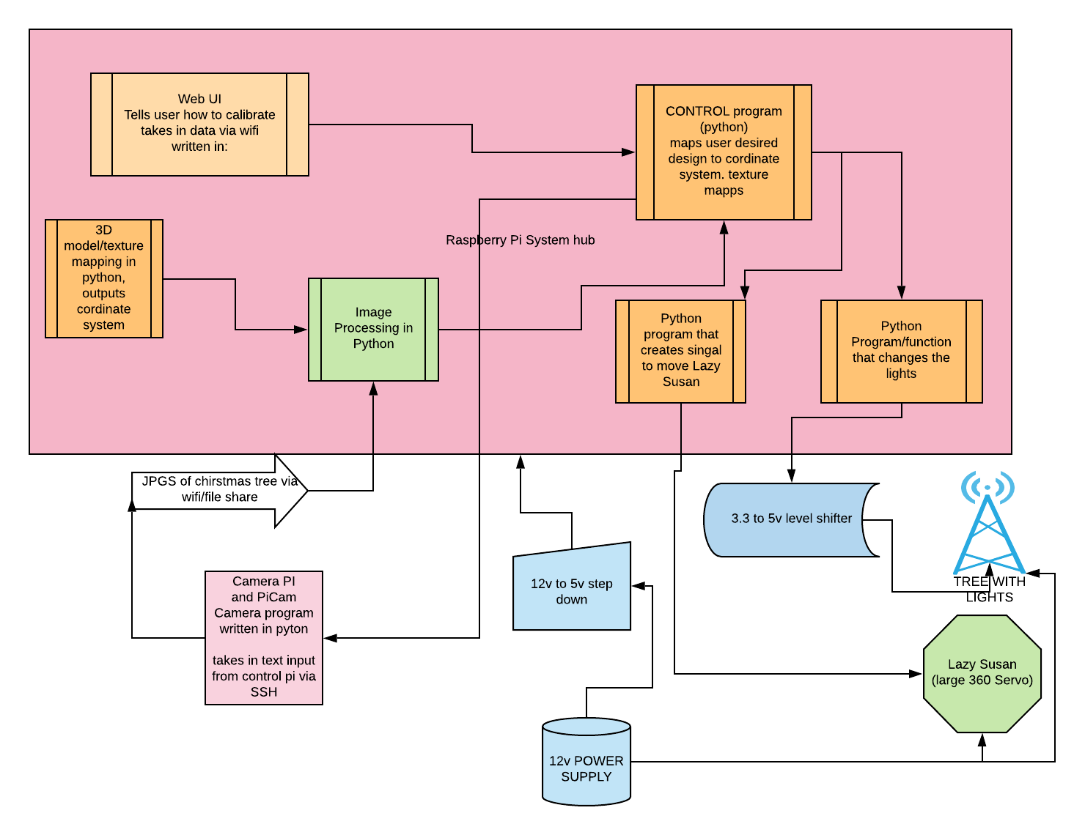
Detailed Design
SDDec19-10
Notes:
Jake: This is our detailed design The main component is the Pi running our server This will control the camera Pi and the possible lazy susan in the future

Slide 15
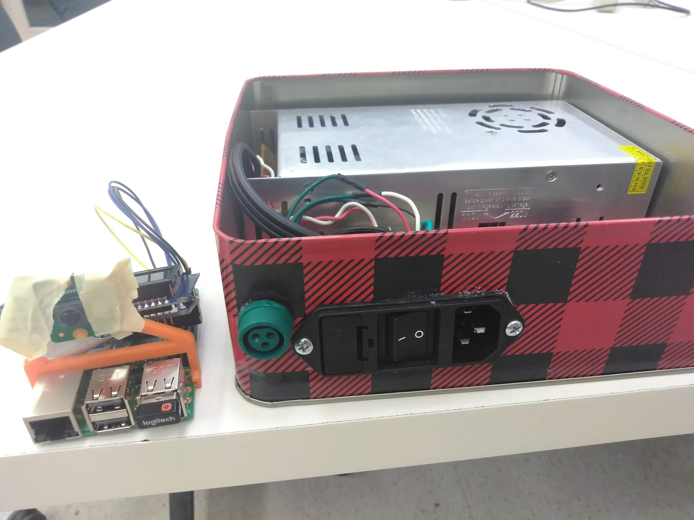
Hardware platforms used
Hardware:
Raspberry Pi
Pi Camera V2
HD44780U (LCD Screen) with i2c / SPI backpack
LM7805 - 12V to 5V voltage regulator
SN74AHCT125 - 3.3V to 5V logic converter
LED light strand (WS2811 chip)
12V 30A power supply
SDDec19-10
Notes:
Chad

Slide 16
Hardware platforms used
Hardware:
Raspberry Pi
Pi Camera V2
HD44780U (LCD Screen) with i2c / SPI backpack
LM7805 - 12V to 5V voltage regulator
SN74AHCT125 - 3.3V to 5V logic converter
LED light strand (WS2811 chip)
12V 30A power supply
Two Raspberry Pi model 3 B’s
Control Pi - controls LEDs, located inside the box. Handles the image processing and calibration
Camera Pi - takes images and sends them to the control pi
SDDec19-10
Notes:
Chad
Raspberry Pi - camera pi will do all the image processing and then send the calibration file to the control pi
Pi Camera V2 - easier than using a users cell phone, allows more control protects against variability in users phones
HD44780U (LCD Screen) and i2c / SPI backpack - used to display IP address of control pi, will later be used to display instructions and other system info
LM7805 - 12V to 5V voltage regulator - voltage regulator from the power supply to the control pi
SN74AHCT125 - 3.3V to 5V logic converter - converts PWM output for LED control to 5V for the LEDS
LED light strand (WS2811 chip) - chip used inside LEDs

Slide 17
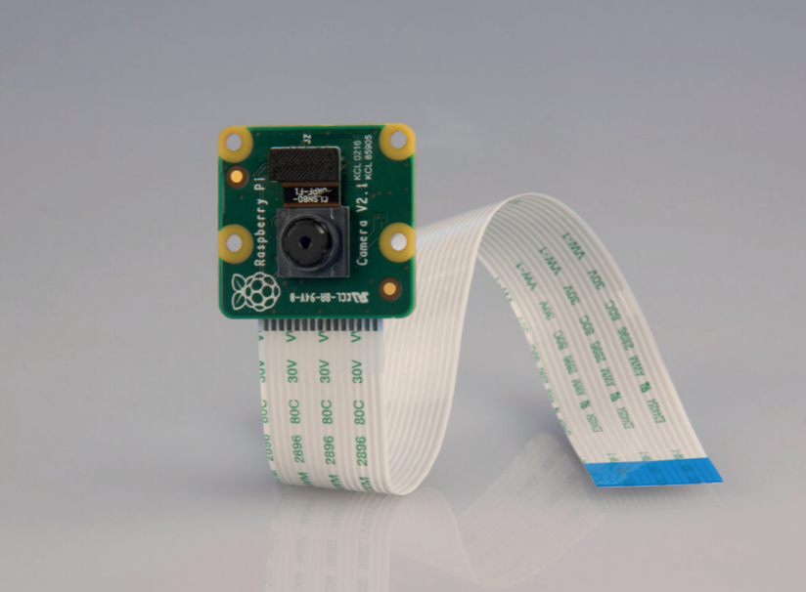
Hardware platforms used
Hardware:
Raspberry Pi
Pi Camera V2
HD44780U (LCD Screen) with i2c / SPI backpack
LM7805 - 12V to 5V voltage regulator
SN74AHCT125 - 3.3V to 5V logic converter
LED light strand (WS2811 chip)
12V 30A power supply
8-megaPixel
Capable of 3280x2464 resolution
1080p 30FPS video; 720p 60FPS
15-Pin ribbon cable and dedicated MIPI Camera Serial Interface (CSI-2) port
Much simpler than using an app and a user’s phone
SDDec19-10
Notes:
Chad
Raspberry Pi - camera pi will do all the image processing and then send the calibration file to the control pi
Pi Camera V2 - easier than using a users cell phone, allows more control protects against variability in users phones
HD44780U (LCD Screen) and i2c / SPI backpack - used to display IP address of control pi, will later be used to display instructions and other system info
LM7805 - 12V to 5V voltage regulator - voltage regulator from the power supply to the control pi
SN74AHCT125 - 3.3V to 5V logic converter - converts PWM output for LED control to 5V for the LEDS
LED light strand (WS2811 chip) - chip used inside LEDs

Slide 18
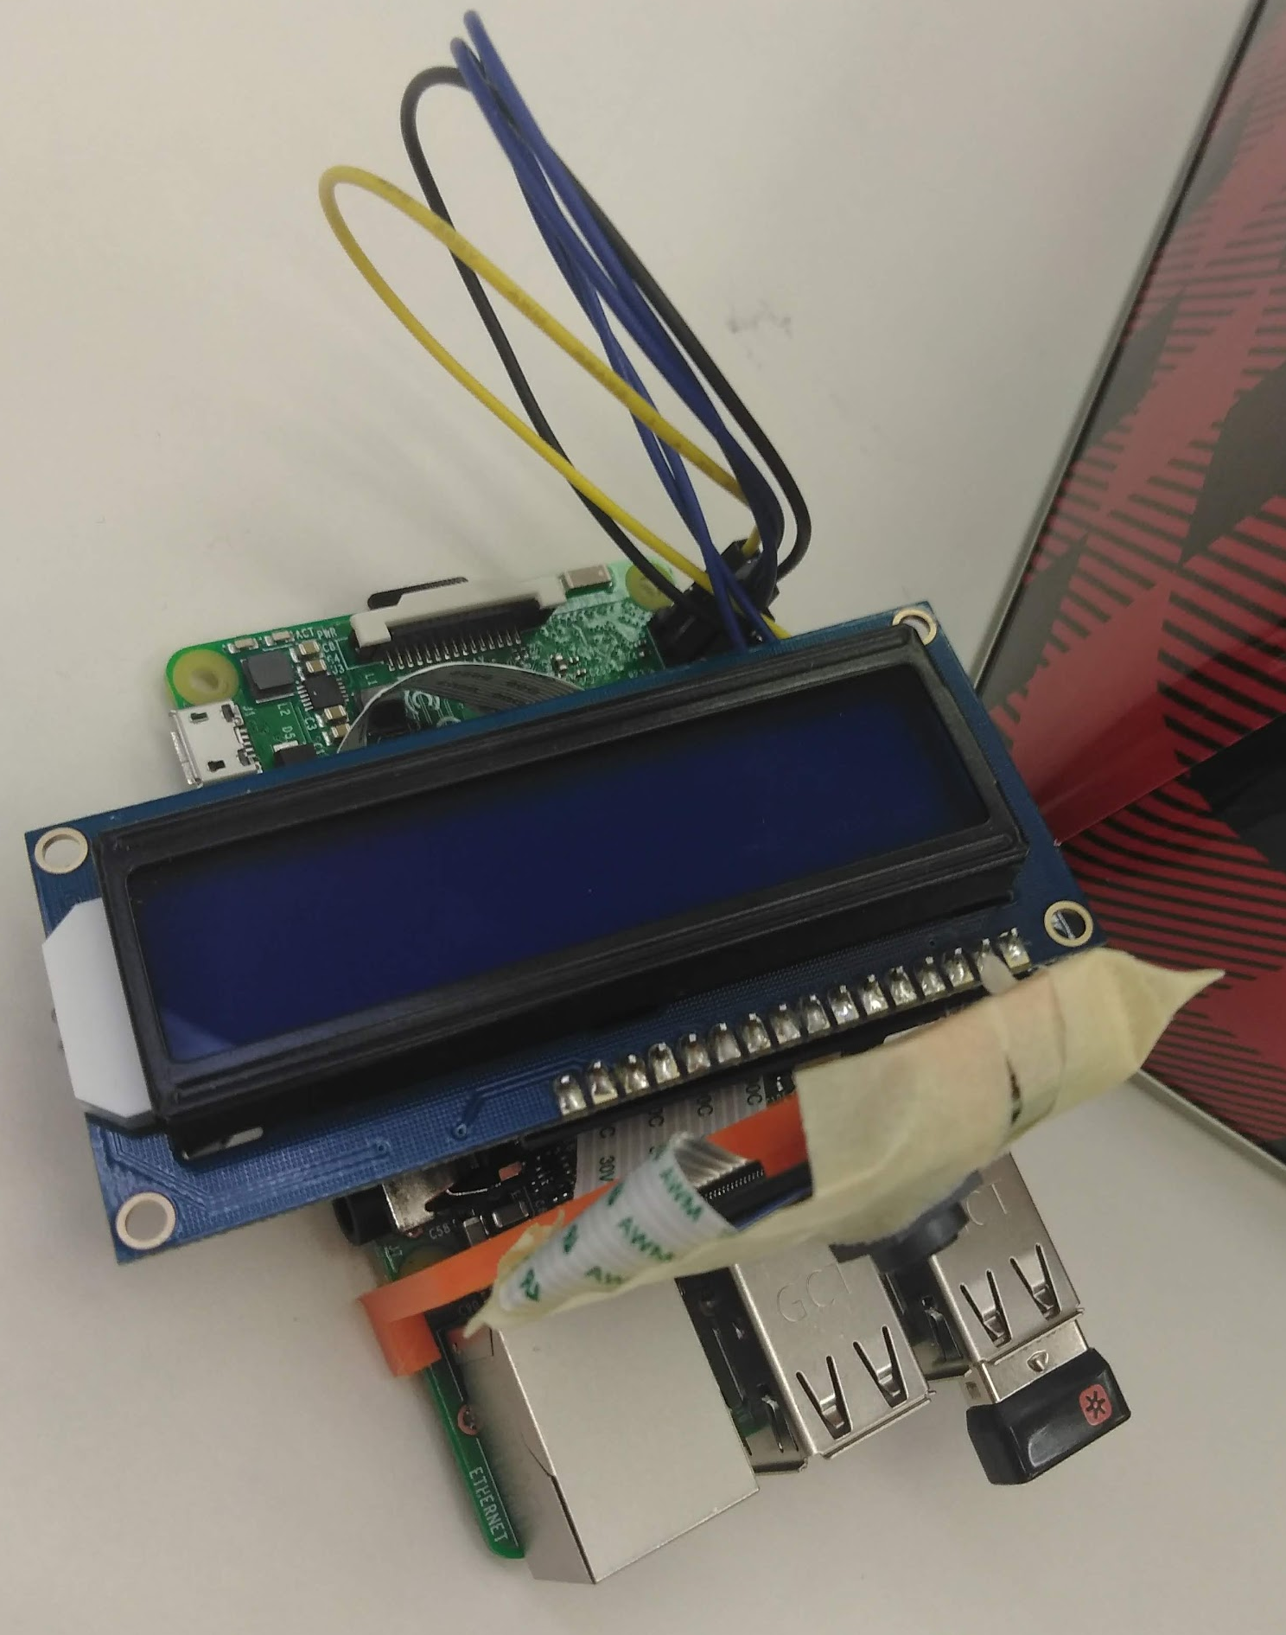
Hardware platforms used
Hardware:
Raspberry Pi
Pi Camera V2
HD44780U (LCD Screen) with i2c / SPI backpack
LM7805 - 12V to 5V voltage regulator
SN74AHCT125 - 3.3V to 5V logic converter
LED light strand (WS2811 chip)
12V 30A power supply
SDDec19-10
Notes:
Chad

Slide 19
Hardware platforms used
Hardware:
Raspberry Pi
Pi Camera V2
HD44780U (LCD Screen) with i2c / SPI backpack
LM7805 - 12V to 5V voltage regulator
SN74AHCT125 - 3.3V to 5V logic converter
LED light strand (WS2811 chip)
12V 30A power supply
SDDec19-10
Notes:
Chad
Raspberry Pi - camera pi will do all the image processing and then send the calibration file to the control pi
Pi Camera V2 - easier than using a users cell phone, allows more control protects against variability in users phones
HD44780U (LCD Screen) and i2c / SPI backpack - used to display IP address of control pi, will later be used to display instructions and other system info
LM7805 - 12V to 5V voltage regulator - voltage regulator from the power supply to the control pi
SN74AHCT125 - 3.3V to 5V logic converter - converts PWM output for LED control to 5V for the LEDS
LED light strand (WS2811 chip) - chip used inside LEDs

Slide 20
Hardware platforms used
Hardware:
Raspberry Pi
Pi Camera V2
HD44780U (LCD Screen) with i2c / SPI backpack
LM7805 - 12V to 5V voltage regulator
SN74AHCT125 - 3.3V to 5V logic converter
LED light strand (WS2811 chip)
12V 30A power supply
SDDec19-10
Notes:
Chad

Slide 21
Hardware platforms used
Hardware:
Raspberry Pi
Pi Camera V2
HD44780U (LCD Screen) with i2c / SPI backpack
LM7805 - 12V to 5V voltage regulator
SN74AHCT125 - 3.3V to 5V logic converter
LED light strand (WS2811 chip)
12V 30A power supply
SDDec19-10
Notes:
Chad
Raspberry Pi - camera pi will do all the image processing and then send the calibration file to the control pi
Pi Camera V2 - easier than using a users cell phone, allows more control protects against variability in users phones
HD44780U (LCD Screen) and i2c / SPI backpack - used to display IP address of control pi, will later be used to display instructions and other system info
LM7805 - 12V to 5V voltage regulator - voltage regulator from the power supply to the control pi
SN74AHCT125 - 3.3V to 5V logic converter - converts PWM output for LED control to 5V for the LEDS
LED light strand (WS2811 chip) - chip used inside LEDs

Slide 22
Software platforms used
Software:
OpenCV
NeoPixel
Pi camera API
PHP/HTTP server
SDDec19-10
Notes:
Jake
Fix this later lol
We used Python as our main language

Slide 23
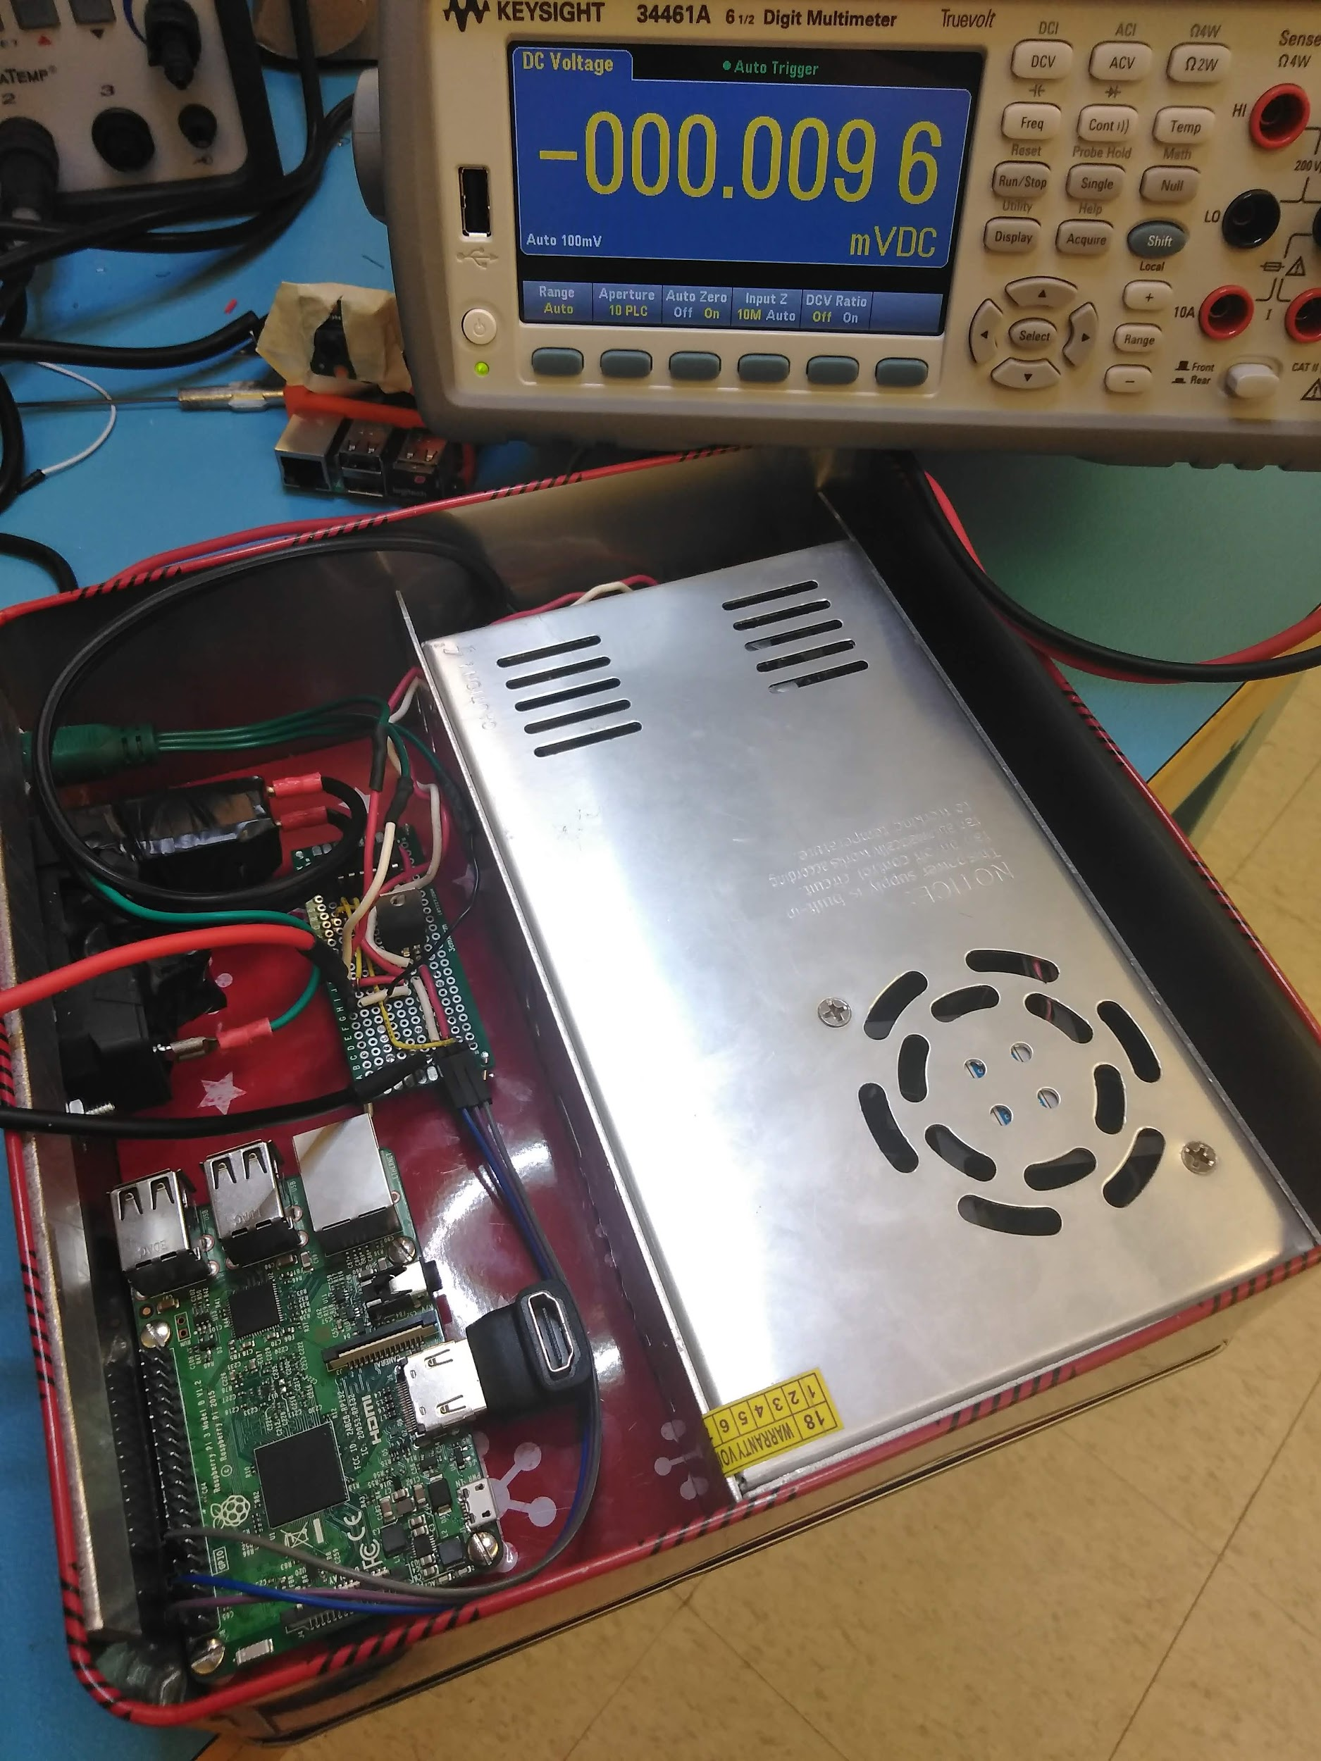
Test Plan
Software
Confirm Interactions with Hardware
Server & Client makes connection
Establish accurate calibration
Handle uploaded image files for lights
Bug-free
Hardware
Verify voltage levels during use
120V Source → 12V Power Supply
LM7805 Chip 12V → 5V
Output of 3.3V:5V Converter
Let the system run for several hours
Monitor temperature
SDDec19-10
Notes:
TN
Dumb as it sounds, we might want to split up speakers (a software engi should talk about the soft, the hardware should be talked about by a hardware Anyone goes for Non-Functional
----
Confirm Interactions -- so a direct connection from the Pi (and our computer), and interaction from the control(PC) -- and its Pins can actually activate the Pi Lights. --- This step currently works.
Server and Client connection. We need to set up the wireless communication between the control pi, the camera pi, and the actual user’s webpage. We are currently working on this process. This relates to the home network connection as well.
Accurate calibration would be our next step. This process would be done by doing a 1 by 1 (2 lights at a time) to understand the relative positions of each light to each other. We’re planning to use next semester to understand image recognition as we don’t have any experience with this portion. What this does is understand the position of each light on the tree on a 2dimensional view. (potentially 3d).
When we can get the relative positions and image recognition -- we can then allow image uploading by users. With the relative positions on the lights -- we can plan to overlay our lights, and get an average of colors around an area (which would correspond to respective lights in said area) -- making the image ‘’’appear on the tree’’’. This won’t be super detailed unless we get a lot of ‘pixels’ on the tree.
Obviously bug free AYY LMAO. this is done by just constantly testing. It’s not always a go once and done -- we need to make sure our foundation (confirm interactions) stays strong as well and not have any spaghetti code (one thing doesn’t affect the other), and is ‘adaptable’
-----
Hardware it someone else’s problem.

Slide 24
Prototype Implementation
Demo?
SDDec19-10

Slide 25
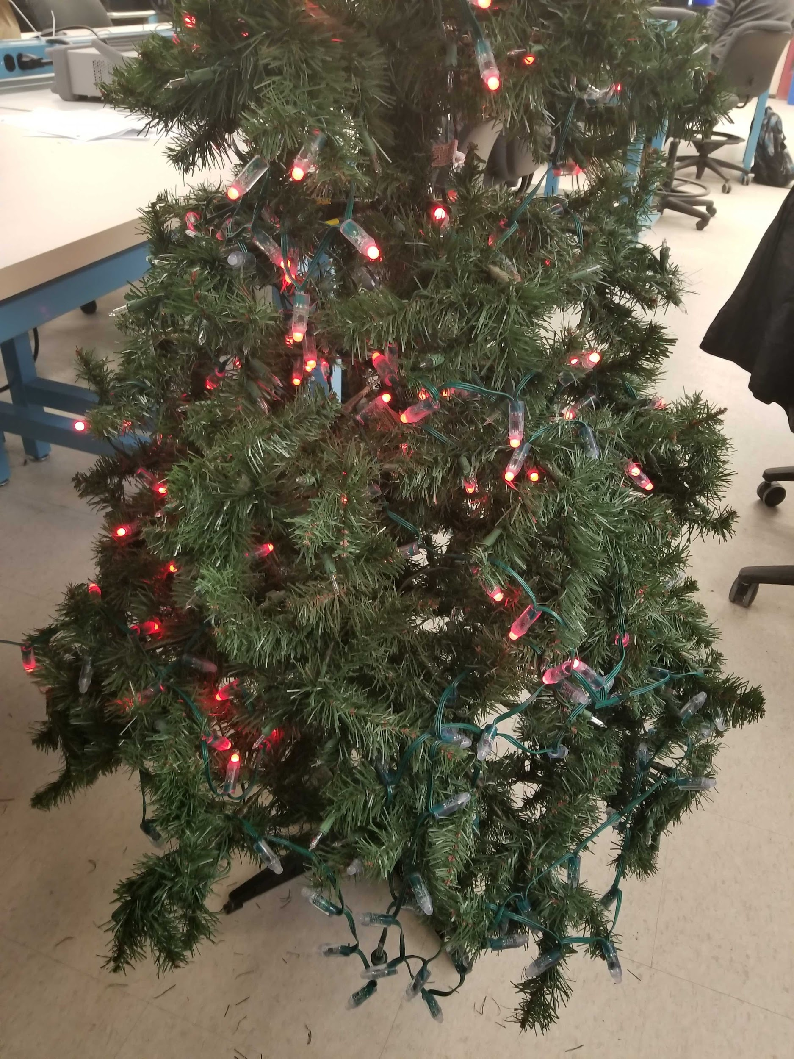
Current Status and Milestones
Milestone 1 (Turn on Lights): Reached April 2nd
Milestone 2 (Patterns and Users): Need to create a Webpage with semi-pre-set patterns
Milestone 3 (Image Uploading): Need to create an image recognition system
Milestone 4 (User Testing): Need to add user-friendliness for connecting to networks
SDDec19-10
Notes:
Jake
Turning on the lights using the power distribution system/control box
Displaying a pattern inputted on the user-Interface
Displaying an image inputted on the user-interface
Testing with users similar to our intended users and having them set-up and use the system

Slide 26
Plans for Next Semester
Finalize the auto-calibration of the system
Fully functional web application
Lazy Susan
Fix power issues
Acquire back-up part and parts for stress-testing
Finalize data that will be displayed on LCDs
SDDec19-10
Notes:
Steve
In no particulatar order:
Finalize auto-cal
Fully functioning web interface
Possibly include a motorized lazy suzan
Repair power issues
Obtain more parts as needed
Determine all types of data displayed on tree

Slide 27
Contributions of Each Member
Team Member | Role | Contributions
Jacob Grace | Software Lead | Testing and developing python code
Steven Williams | Hardware Lead | Creating web UI, creating physical box layout and connections
Valery Smith | Signal Processing Specialist | Set-up samba file-share on Pis, wrote python script for taking pictures, systems decisions and diagrams
Joseph Nunez | Meeting Scribe | Researched image recognition methods and applications for the project. Took meeting notes for every team meeting with Dr Daniels. Wrote sample code for testing the Pi Displays
Thien Nguyen | Webmaster | Uploaded/Maintain Website, Sample Light Code, Enforced Electrical Safety
Chad Griggs | Report Manager | Created diagrams and circuit schematic Hardware implementation and testing
SDDec19-10
Notes:
You’ll get my name right eventually

Slide 28
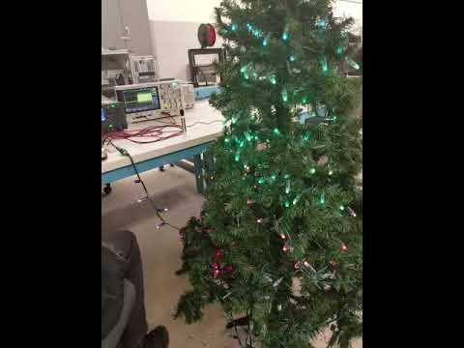
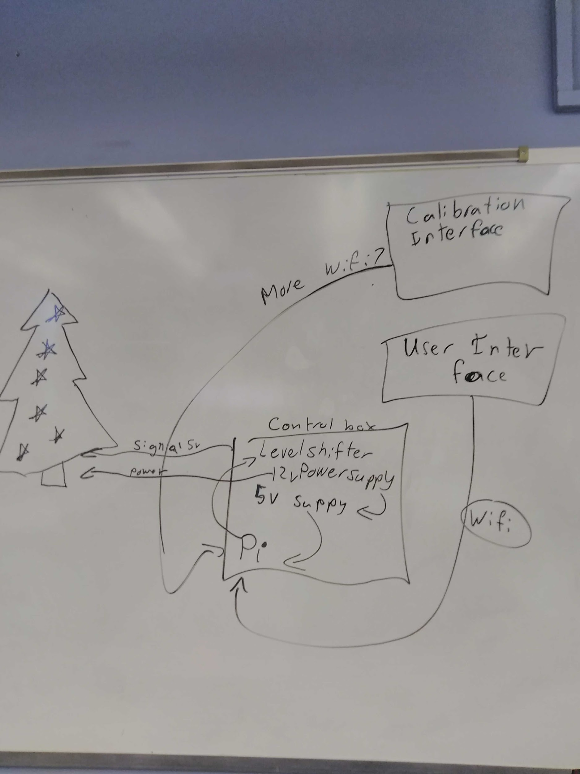
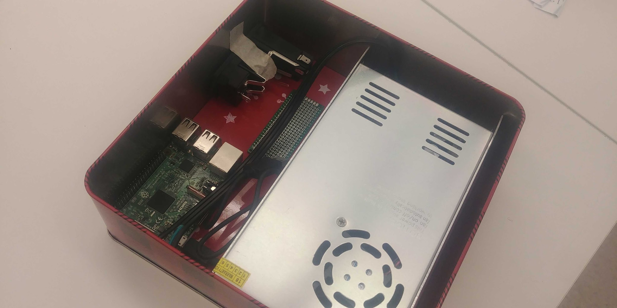
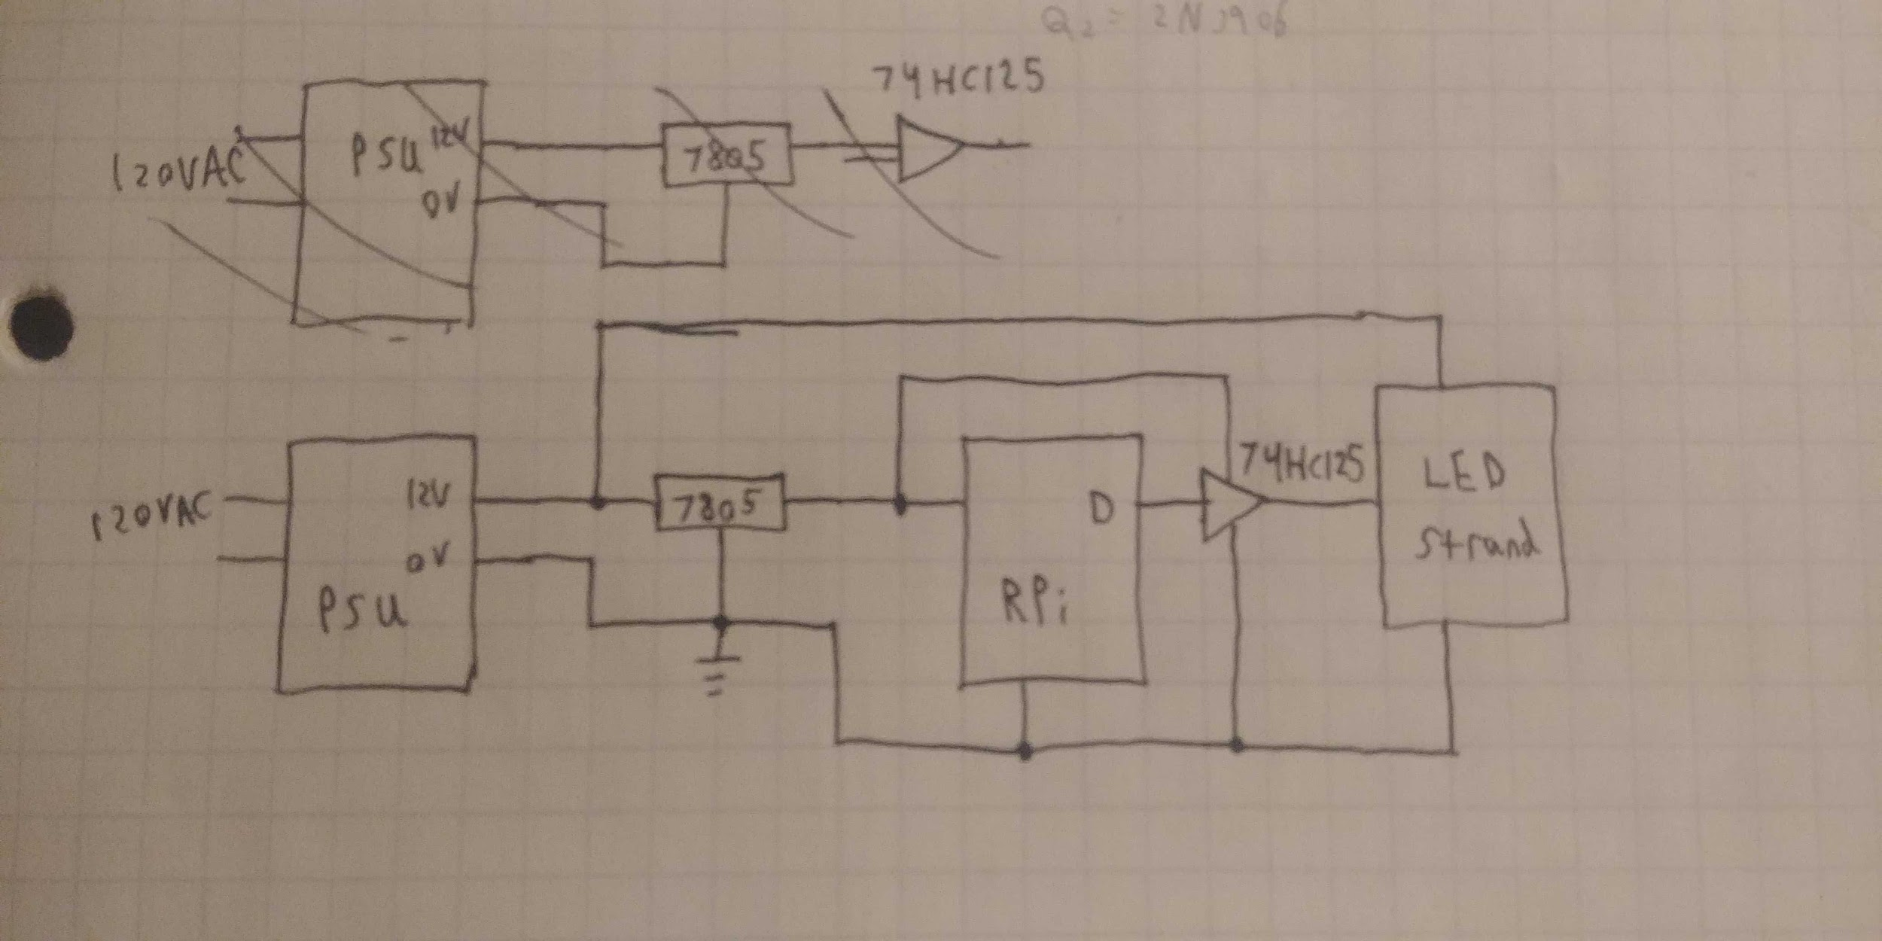
Imageful Resources (Hidden by Default)
Use these for your slides Could be more in slack or docs or whatever

Slide 29
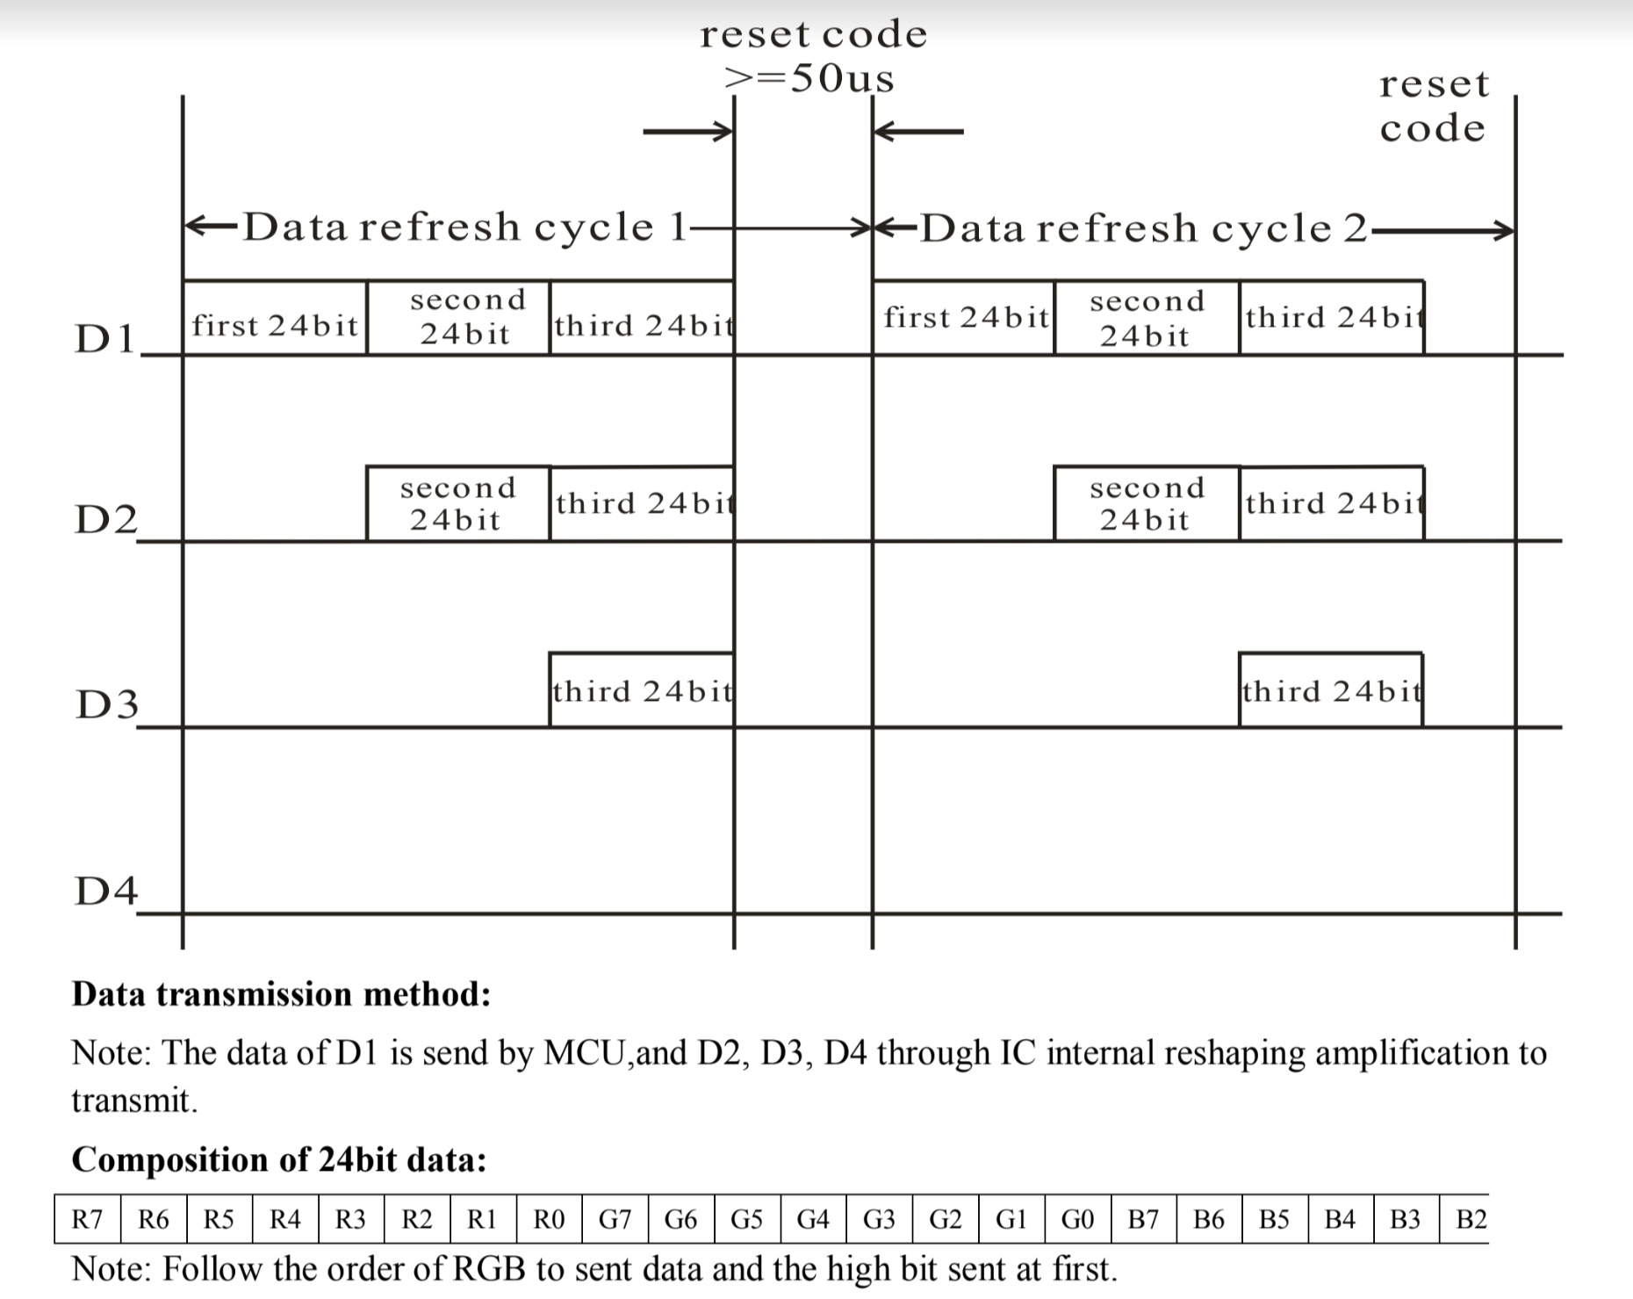
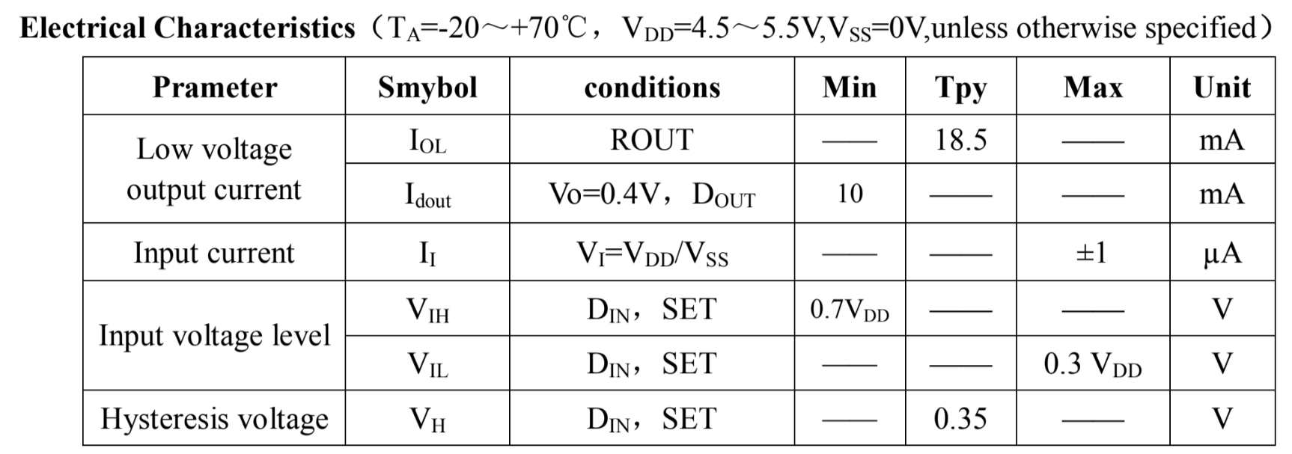
WS2811 Datasheet

Slide 30
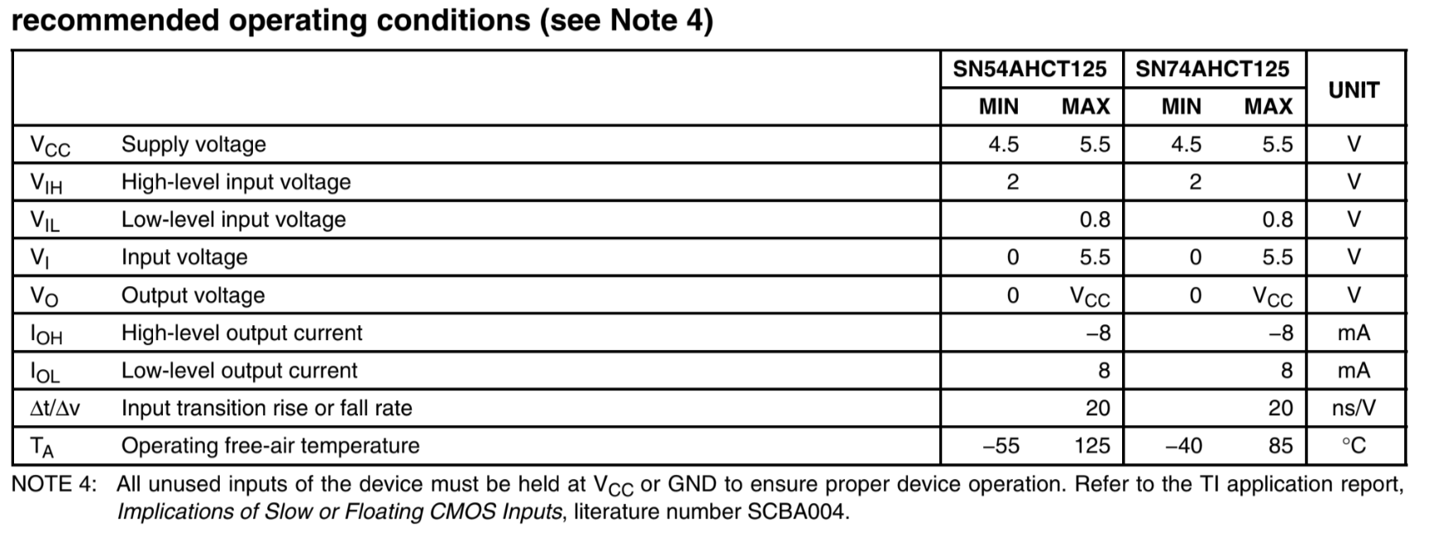
SN74AHCT125

